Slide 1
Graphics Display Devices
Sunirmal Khatua
Department of Computer Science & Engineering
University of Calcutta

Slide 2
Graphics Devices
Various Input devices:
  Keyboard
  Scanner
  Mouse
  Joystick
  Touch Screen
  Track ball
Various Display devices:
  CRT
  Plotters
  Printers
  Flat panel devices
The most commonly used display device is the CRT (Cathode Ray Tube)

Slide 3
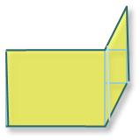

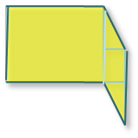

CRT Basics
Horizontal Deflection Plates
Vertical Deflection Plates
Cathode
Focusing System
Control Grid
Accelerating Anode
Deflection System
Focusing Anode
Phosphor-coated Screen

Slide 4
CRT Basics (cont.)
Phosphor properties
  Fluorescence: Light emitted while the phosphor is being struck by electrons
  Phosphorescence: Light emitted even while the electron beam is removed
  Persistence: The time from the removal of the excitation to the moment when phosphorescence has decayed to 10% of the initial light output
CRT properties
  Resolution: The number of points that can be plotted horizontally and vertically without overlap in a CRT screen.
  Aspect Ratio: The ratio of vertical points to horizontal points necessary to produce equal length lines in both direction.
Types of CRT display
  DVST (Direct View Storage Tube) display
  Random Scan display
  Raster Scan display
Notes:
Light intensity follow the Gaussian distribution. So two adjacent spots will appear
distinct as long at their seperation eact spot has intensity of about 60% of the initial value.

Slide 5




DVST Display
Flood Cathode
Storage Grid

Slide 6
DVST Display (cont.)
CRT with a long persistence phosphor through secondary emission.
A slow moving electron beam draws a line on the screen.
Image is stored as a distribution of charges on the storage grid.
Advantages:
  Provides flicker-free display
  No refreshing necessary
Disadvantages:
  Modifying any part of the image requires redrawing the entire modified image.
  Slow process of drawing – needs few seconds for a complex picture.
  Erasing (discharging the storage tube) needs aprox. 0.5 seconds.
  Animation is not possible.

Slide 7
Random Scan Display
Also called Calligraphic, Stroke or Line drawing displays – because images or characters are drawn as a sequence of strokes ( or short lines )
Also called Vector displays – because electron beam is deflected from end-point to end-point
Called Random Scan – because order of deflection is arbitrary.
It needs refresh since phosphor has short persistence – decays in 10-100μs. Display is generally refreshed at regular intervals – minimum of 30Hz(fps)

Slide 8
Random Scan Display (cont.)
Conceptual Block Diagram:
Display Buffer – also called Refresh buffer. It’s a memory space allocated to store the display list or display program for the display processor to draw pictures.
The Display Processor interprets the commands in the display buffer for plotting in the CRT.
The display processor must cycle through the display list to refresh the phosphor.
The display processor sends the digital and point coordinate data to the Vector Generator.
The Vector Generator converts the digital and co-ordinate values to analog voltages for the Focusing and Deflection circuits. The points along the lines are computed using the line equation y = m.x + b
Animation is possible with segmentation (limited capability) - a mixture of static and dynamic parts of a picture.
Host
CPU
Display
Buffer
Display
Controller
Display
Processor
Vector/Character
Generator
CRT

Slide 9
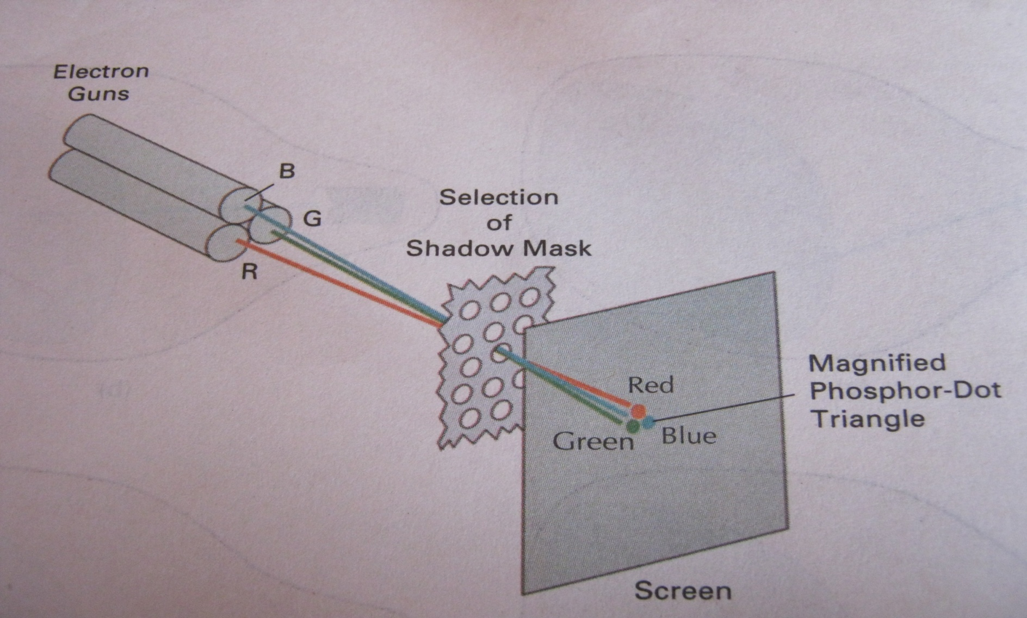
Raster Scan Display
Used in most display system including Television.
The term Raster is used for a scanning pattern of parallel lines that forms the display of an image on a display screen.
Unlike DVST and Random scan CRT which were line drawing devices, Raster scan CRT is a point plotting device.
Raster scan display stores the display primitives (line, polyline, filled area etc) in a Refresh buffer (also called Frame buffer) in terms of points and pixels components.
Entire screen is a matrix of pixels and has a correspondence to an addressable point in the refresh buffer.
Horizontal Retrace
Scan Line
Vertical Retrace
Notes:
Beam penetration(random scan – for red and green additionally orange and yellow), shadow mask(metal with holes) and in-line(along scan line)

Slide 10
Raster Scan Display (cont.)
Rasterization is the technique that converts display primitives into pixel components. This causes the effect of “aliasing”, “jaggies” or “staircase” effect
Architecture of a Raster scan display system
Picture Element, Pixel
Addressable point
B
A
DP Memory
Frame Buffer
Video Controller
CRT
CPU
Display Processor
System Memory
System Bus
I/O Devices

Slide 11
Raster Scan Display (cont.)
Video Controller Refresh Operation
  Initially x register is set to 0 & y register is set to y_{max}
  The value stored in the frame buffer is then retrieved to set the intensity of the CRT beam.
  The process is repeated by incrementing x register up to x_{max}
  Step 3 is repeated by resetting x to 0 and decrementing y up to 0 (Horizontal Retrace) .
  The whole process is repeated once y becomes 0 (Vertical Retrace).
Refresh Rate required is 60 Hz to avoid flickering.
  Interlaced refresh procedure is used to allow a refresh rate of 30Hz without flickering.
  Interlaced display works in two passes – refreshing even scan line in one pass while refreshing the odd scan line in other pass.
Raster Scan Generator
Horizontal & Vertical Deflection Voltages
x
Register
y
Register
Pixel Register
Intensity Control Voltages
Memory Address Register
Frame Buffer

